Slide 1

Sanjivani collage of engineering Kopargaon
Department of computer Engineering
Subject: Database management system
Topic :PostgreSQL
Guided By: Dr.P.Saiprasad.
Group members : Jangam Janhavi [147]
Mukta Puri [150]
Mali Rutuja[152]

Slide 2
INDEX
Introduction
Features of prostgresql
Advantages and Disadvantages
Differece ProstgreSQL & MySQL
Installation Process
Conection of ProstgreSQL
Basic operation on PgAdmin 4
Basic operation on Cmd
Conclusion
References

Slide 3
Introduction
Postgresql is a powerfull, extremely stable and object relational database system.
Postgresql is one of the popular and trustworthy database system. that is used by organization specially startup for their backend development.
Simplest things about postgresql are:
It is open source
Robust
High performance
Community
Postgresql uses sql as its main query language.
All level of developers beginners to professional uses a postgresql to manage their info regardles of the diamensions of the information.
It works clearly on each huge and tiny data sets.

Slide 4
Features of ProstgresSQL
Free to download: It is open-source, and we can easily download it from the official website of PostgreSQL.
Compatible on several operation systems: PostgreSQL runs on all major operating systems such as Microsoft Windows, Linux, MacOS X, UNIX (AIX, BSD, HP-UX, SGI IRIX, Solaris, and Tru64), etc.
Compatible with various programming languages: It supports multiple programming interfaces such asC/C++, JAVA, Python, Perl, Ruby, Tcl, and ODBC (Open Database Connectivity).

Slide 5
Advantages & Disadvantages
Advantage
ACID supported
Community support
It is open source
Cables of handling high-performance jobs.
Security
Scalable
Fast data processing
Disadvantages
PostgreSQL isolate each client, implying that a separate service Thread is started for each client.
PostgreSQL installation is more difficult than that of other DBMS programmers.
Less knowledge of PostgreSQLs capabilities.

Slide 6
Differece ProstgreSQL & MySQL
S.no | MySQL | ProstgreSQL
1. | It is most popular DataBase. | It is most Advanced DataBase.
2. | It is a relational-based DBMS | It is a object-based DBMS
3. | The Implimention language is c/c++ | The Implimention language is c
4. | It supports the CASCADE option | CASCADE option is supported
5. | SQL only supports Standard data types | It supports Advanced data types such as arrays and user-defined types.
6. | It is reliable, simple, and faster. | It is slower and more complex.
7. | Troubleshooting MySQL is easy. | It is difficult to troubleshoot PostgreSQL.
8. | SQL provides limited MVCC support | Full MVCC support.

Slide 7
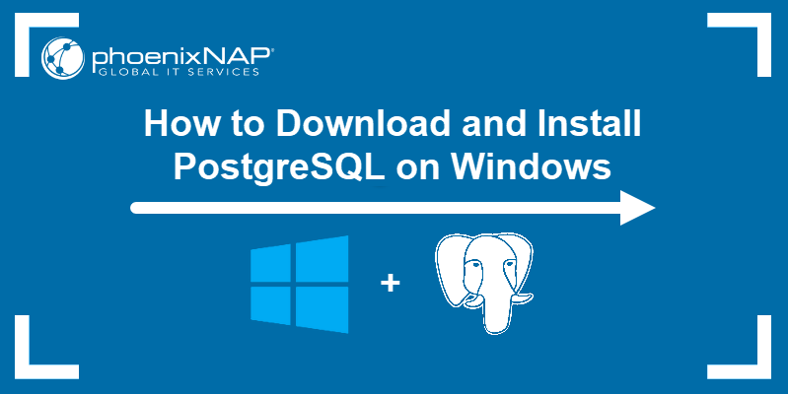
Installation Process

Slide 8
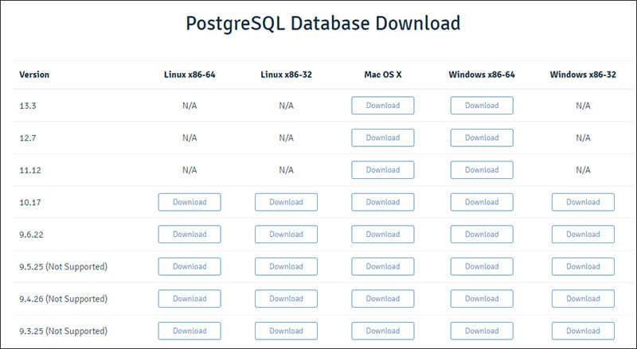
Download PostgreSQL Installer
Before installing PostgreSQL, you need to download the installation file from the EDB website.
Find the Windows x86-64 category for the latest version of PostgreSQL and click the Download button.

Slide 9
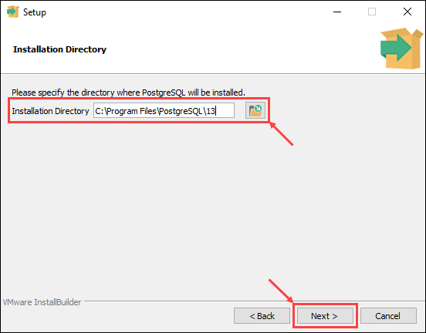
Install PostgreSQL on Windows
Follow the steps below to install PostgreSQL on Windows:
1. Open the PostgreSQL install file to start the installation wizard. Click Next to continue.
2. Choose an install location for PostgreSQL and click Next to proceed.

Slide 10
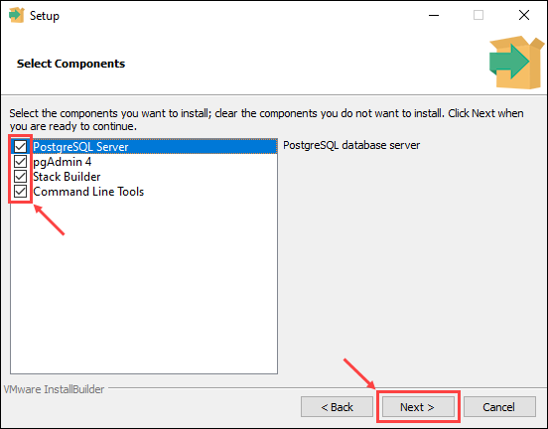
3. Select which software components you want to install:
PostgreSQL Server: Installs the PostgreSQL database server. pgAdmin 4: Provides a graphical interface for managing PostgreSQL databases.
Stack Builder: Allows you to download and install additional tools to use with PostgreSQL.
Command Line Tools: Installs the command line tool and client libraries. Required when installing PostgreSQL Server or pgAdmin 4.
Once you check the boxes next to the components you want to install, click Next to continue.

Slide 11

4. Choose a database directory to store data and click Next to continue.

Slide 12
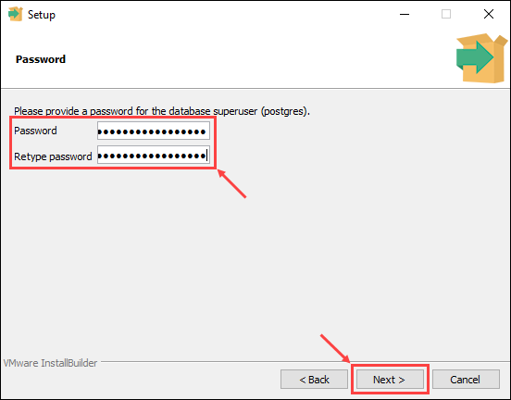
5. Enter and retype the password for the database superuser. Click Next to proceed.

Slide 13
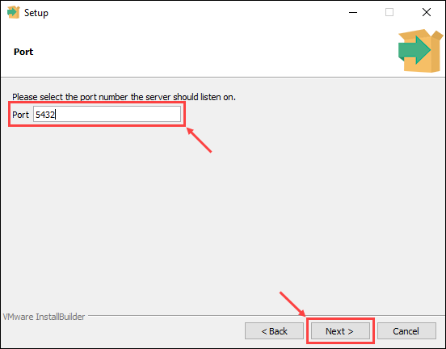
6. Enter the port number for the PostgreSQL server to listen on and click Next to continue.

Slide 14
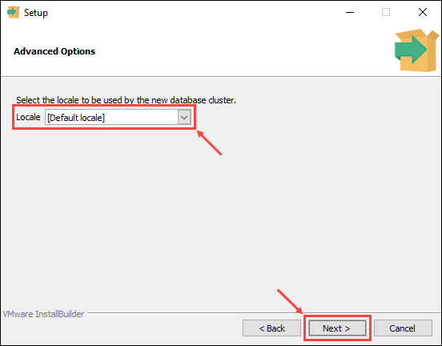
7. Choose the locale for the database to use. Selecting the [Default locale] option uses the locale settings for your operating system. Once you have chosen a locale, click Next to continue.

Slide 15
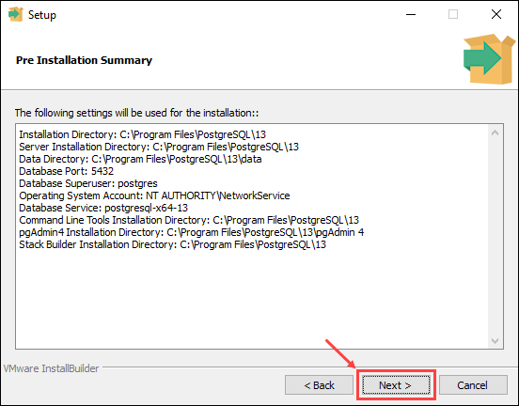
8. The last step offers a summary of the installation settings. Click Back if you want to change any of the settings you made, or click Next to proceed.

Slide 16
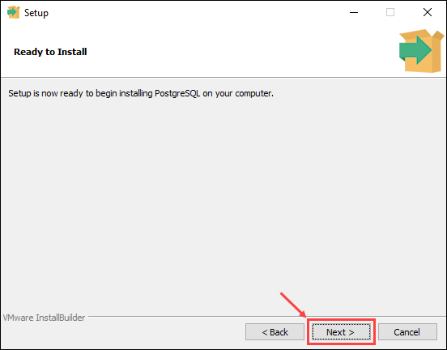
9. The setup wizard informs you it is ready to start the installation process. Click Next to begin installing PostgreSQL.

Slide 17
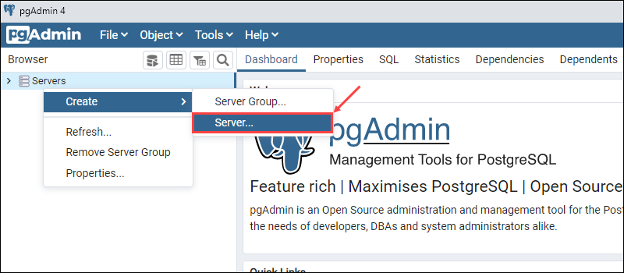
Connect to the PostgreSQL Database Using pgAdmin
1. Open the pgAdmin 4 tool from the PostgreSQL folder in the Start menu.
2. Right-click the Servers icon on the left-hand side. Select Create > Server to set up a new database server.

Slide 18
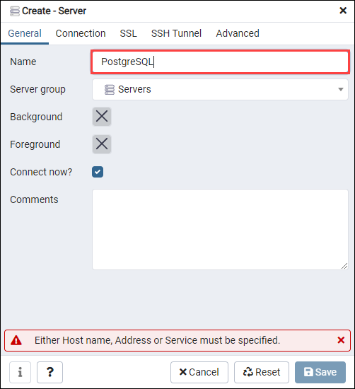
3. In the General tab, enter the name for the new database. In this example, we are using PostgreSQL as the database name.

Slide 19
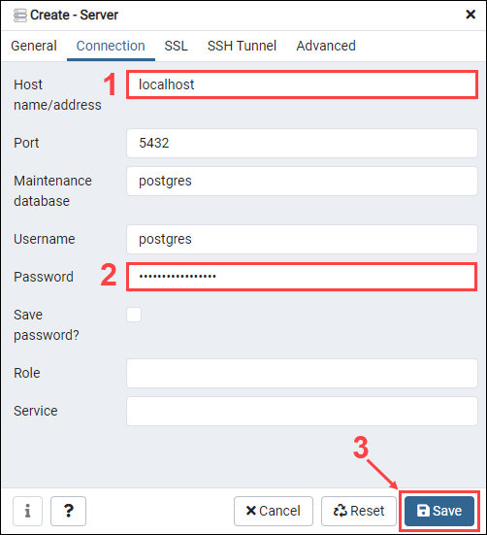
4. In the Connection tab, enter the hostname (default is localhost) and password selected during the setup process. Click Save to create the new database.

Slide 20
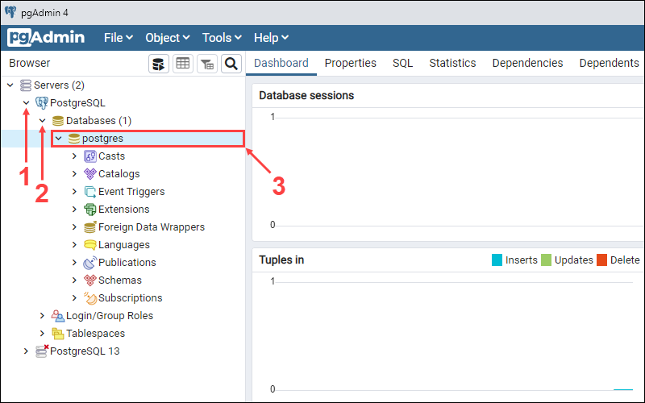
5. Expand the server display by clicking on the Servers > PostgreSQL icons on the left-hand side. Select the default postgres database.

Slide 21
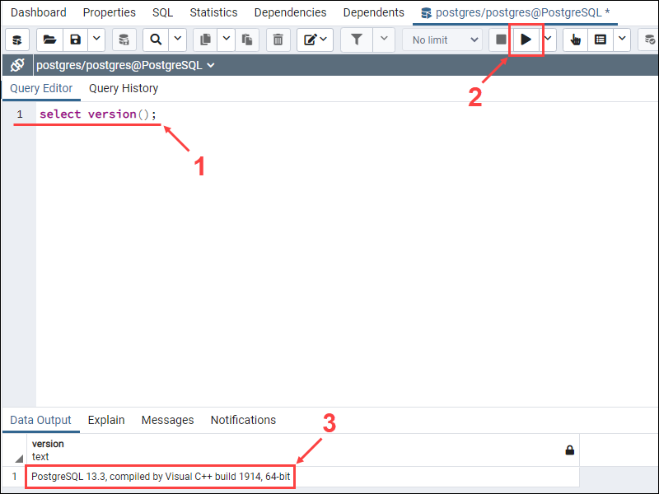
If the database is working properly, the current version of the database will appear in the Data Output section.

Slide 22
Limit and offset options
Limit and offset are used when you want to retrived only few records from your result of queries .
Limit will retrive only the number of records specified after the limit keywords, unles the query itself returns fewer records than the numbers specified by limit.
OFFSET is used to skip the number of records from the result
Example:

Slide 23
Pattern matching function
Like
The like expression returns true if the string matches the supplied pattern.
As expected ,the NOT LIKE expression return false if LIKE returns true and vice vera.
Example:
Select * from emp where name like ’abc’;
Select * from emp where name not like ’abc’;
Similar to
the similar to operator succeeds only if its pattern matches the entire string.
This is unlike common regular expression behaviour where the pattern can match any of the string.

Slide 24
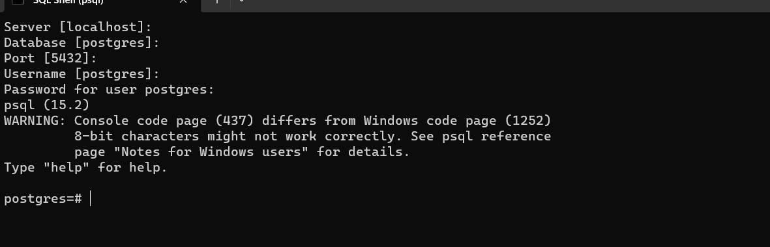

Slide 25
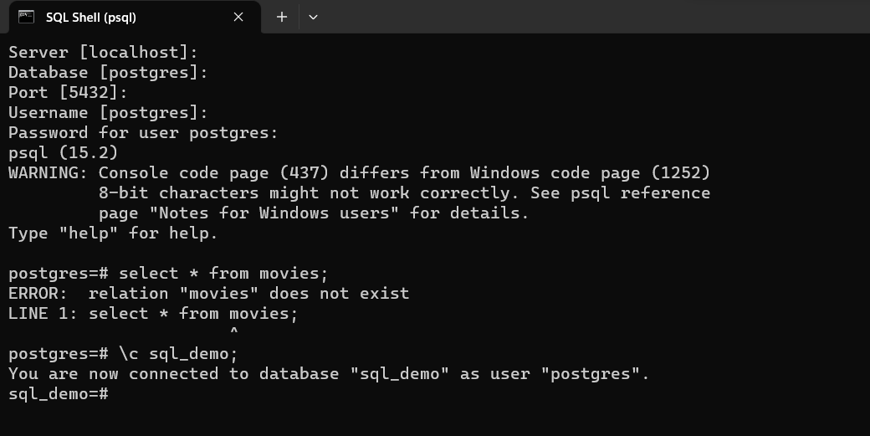

Slide 26
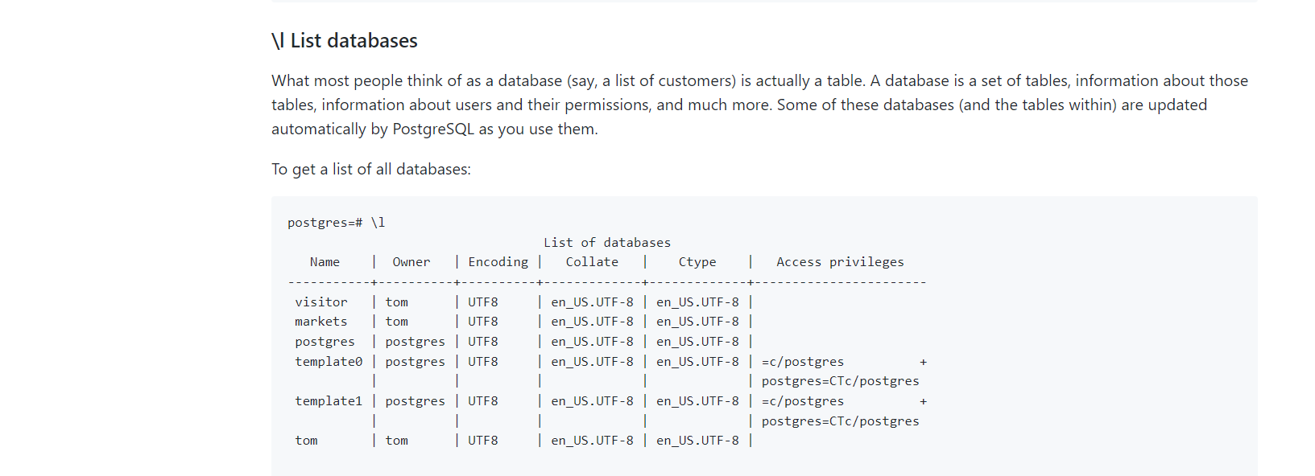
Warning: SQL commands end with a semicolon!
psql vs SQL commands
psql has two different kinds of commands. Those starting with a backslash are for psql itself, as illustrated by the use of \q to quit.
Those starting with valid SQL are of course interactive SQL used to create and modify PostgreSQL databases.
For example,suppose you want to remove a table named sample_property_5. You’d enter this command:
postgres=# DROP TABLE "sample_property_5";
It’s easy to forget. If you do forget the semicolon, you’ll see this perplexing prompt. Note that a [ has been inserted before the username portion of the prompt, and another prompt appears below it:
[postgres=# DROP TABLE "sample_property_5" postgres=#

Slide 27
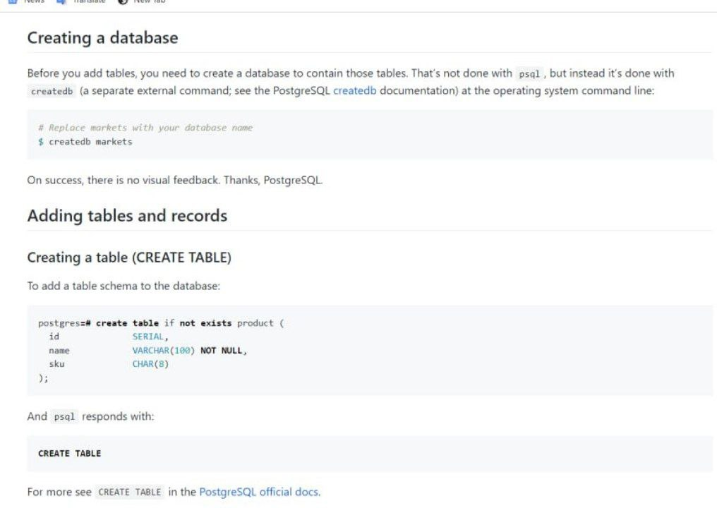

Slide 28
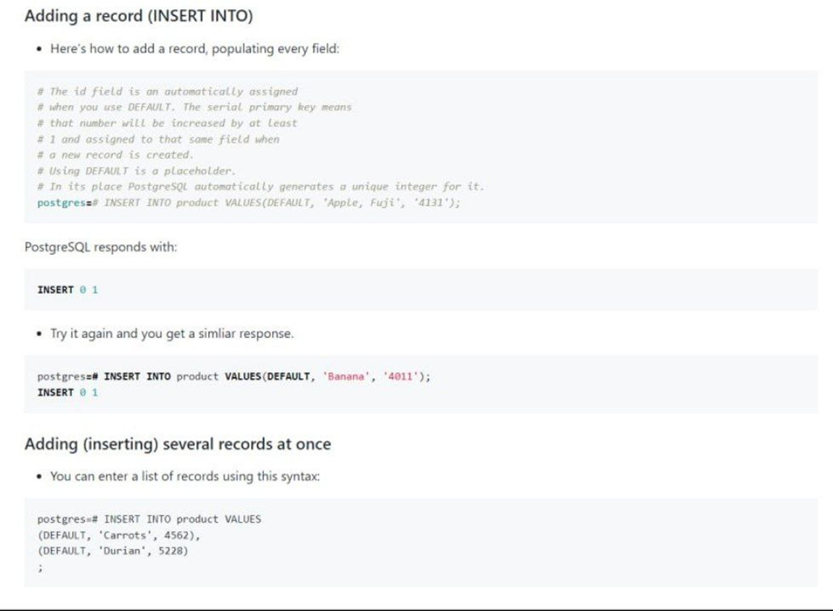

Slide 29
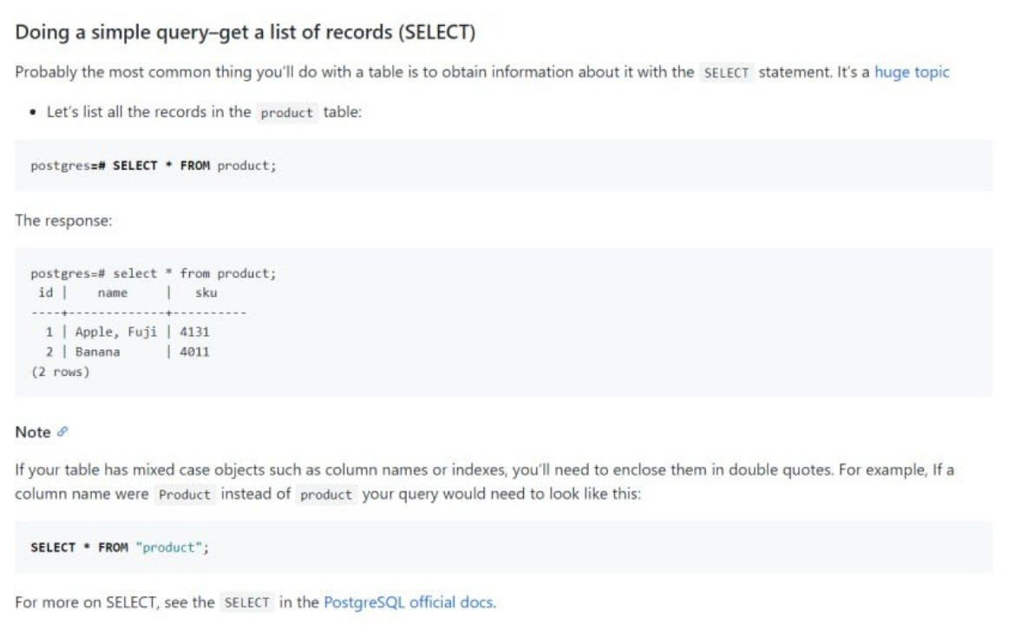

Slide 30
Conclusion
Through this topic we are able to learnt about ProsgreSQL, ProsgreSQL features. Advantages , Disadvantages ,Dofference of MySQL And ProsgeSQL.
installation of ProsgreSQL ,curd operations like create, insert, update, remove, etc.

Slide 31
Reference
https://infyspringboard.onwingspan.com/web/en/app/toc/lex_auth_01329460910229913614313_shared/ov
THANK YOU

